Slide 1
Metropolitan Business Feasibility
Executive Summary · CBP 2023 + ACS 2024 + BLS 2024 + BEA RPP 2024
386 metros · 9 business categories · 369,496 CBP rows analysed

Slide 2
Data Stack
Four official public sources, all government-provided
Dataset | Year | Provider | Coverage
County Business Patterns | 2023 | U.S. Census Bureau | 369,496 rows, 925 metro/micro areas
American Community Survey | 2024 | U.S. Census Bureau | 393 metros — income + population
BLS Metro Unemployment | 2020-2024 | Bureau of Labor Statistics | 5-year annual unemployment
BEA Regional Price Parities | 2024 | Bureau of Economic Analysis | All-items + Housing index per MSA
• BEA RPP is the cost-of-living lever — it shifts the rankings to favor affordable metros.
• After RPP integration: San Francisco fell from #2 to #4; Midland TX rose to #2.
• All four sources are publicly available with no licensing cost.
• Pipeline is reproducible end-to-end via `python3 main.py`.

Slide 3
Key Findings
What the data tells us about U.S. metro feasibility
METROS ANALYSED
BUSINESS TYPES
HIGH-OPPORTUNITY
AVG MEDIAN INCOME
AVG UNEMPLOYMENT
CBP ROWS
386
9
116
$76,409
4.04%
369,496
TEST ACCURACY
TEST F1
TEST ROC-AUC
TEST R²
AVG COL INDEX
AVG REAL INC.
0.8333
0.7451
0.9020
0.5128
94.9
$80,096

Slide 4
Top 10 Metros by Opportunity Score
After cost-of-living adjustment (BEA RPP)
# | Metro | Region | Opp. | Income | Real Inc. | CoL | Unemp.
1 | San Jose-Sunnyvale-Santa Clara, CA | West | 0.723 | $164,801 | $149,245 | 110.4 | 4.20%
2 | Midland, TX | South | 0.617 | $89,627 | $93,573 | 95.8 | 2.90%
3 | Bozeman, MT | West | 0.597 | $103,918 | $101,374 | 102.5 | 2.30%
4 | San Francisco-Oakland-Fremont, CA | West | 0.577 | $135,590 | $117,279 | 115.6 | 4.20%
5 | Sioux Falls, SD-MN | Midwest | 0.571 | $82,509 | $91,038 | 90.6 | 1.70%
6 | Bismarck, ND | Midwest | 0.571 | $86,769 | $95,325 | 91.0 | 2.30%
7 | Casper, WY | West | 0.570 | $71,381 | $76,076 | 93.8 | 3.30%
8 | Bridgeport-Stamford-Danbury, CT | Northeast | 0.570 | $116,402 | $108,925 | 106.9 | 3.10%
9 | Minot, ND | Midwest | 0.560 | $70,782 | $81,332 | 87.0 | 2.50%
10 | Rapid City, SD | Midwest | 0.556 | $78,056 | $87,546 | 89.2 | 1.80%

Slide 5
Best Markets per Business Category
Top metro for each of the 9 business categories
Business | Top metro | Score | Strategy
Construction / Trades | Bozeman, MT | 90.1 | Established Leader
Education / Childcare Services | Boulder, CO | 80.2 | Established Leader
Finance / Insurance Services | Bloomington, IL | 83.3 | Established Leader
Health Clinic / Care Service | Boulder, CO | 82.4 | Established Leader
Professional Services Firm | Boulder, CO | 87.7 | Established Leader
Restaurant / Food Service | Bozeman, MT | 82.7 | Established Leader
Retail Store | Bozeman, MT | 84.7 | Established Leader
Salon / Repair / Personal Services | Washington-Arlington-Alexandria, DC-VA-MD-WV | 84.0 | Established Leader
Technology / IT Services | San Jose-Sunnyvale-Santa Clara, CA | 96.9 | Established Leader

Slide 6
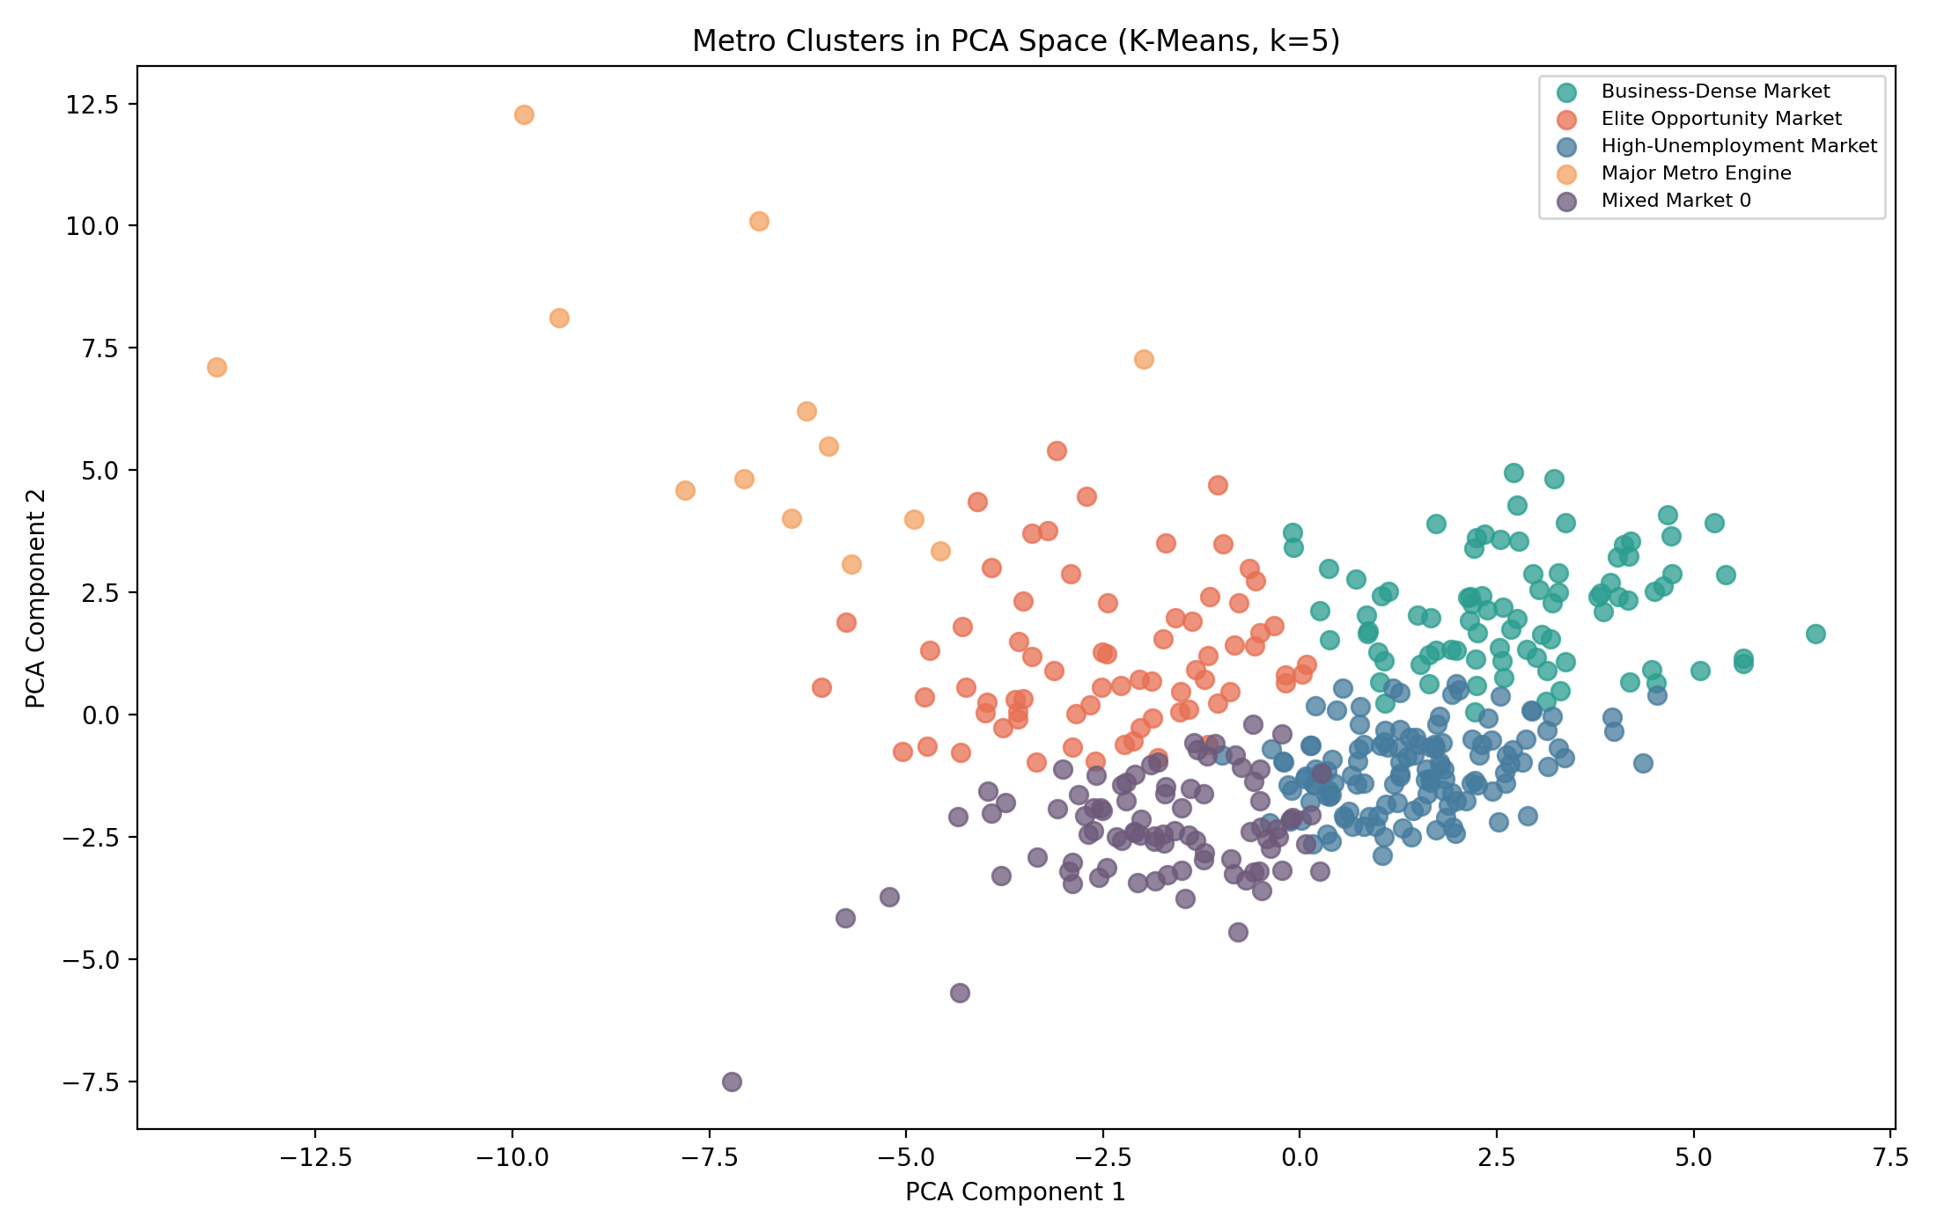
Metro Clusters (K-Means k=5)
Five economic archetypes auto-named from feature centroids
Cluster | Metros | Avg Opp. | Avg Income | Avg Unemp.
Major Metro Engine | 13 | 0.510 | $106,296 | 4.05%
Elite Opportunity Market | 71 | 0.486 | $87,420 | 3.52%
Mixed Market 0 | 87 | 0.451 | $71,818 | 3.80%
Business-Dense Market | 86 | 0.446 | $82,436 | 4.05%
High-Unemployment Market | 129 | 0.413 | $66,417 | 4.47%

Slide 7
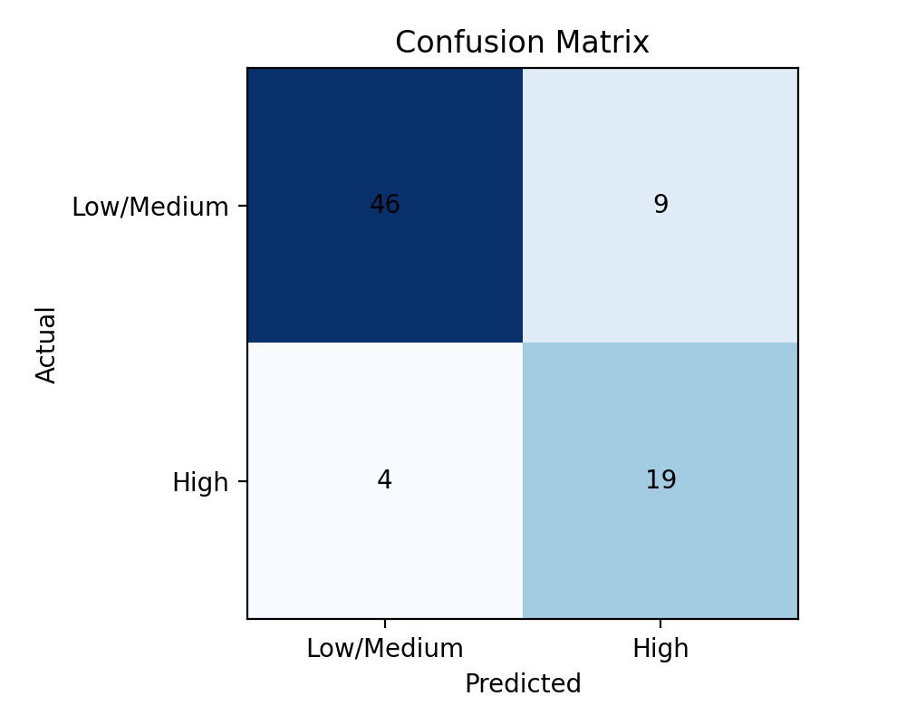
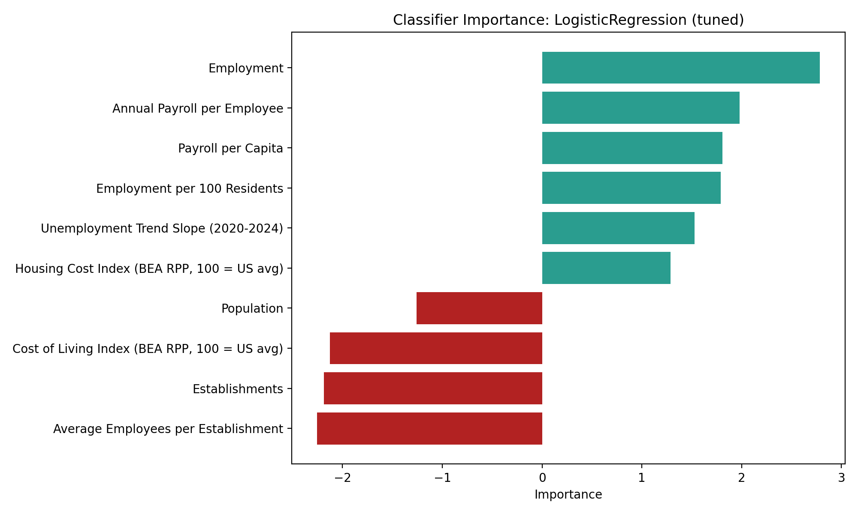
Model Performance
Validation comparison & winning models
Classifier | Val F1 | Val AUC
LogisticRegression | 87.5% | 97.5%
VotingClassifier | 76.9% | 97.3%
GradientBoostingClassifier | 70.0% | 91.6%
RandomForestClassifier | 54.5% | 94.8%
Regressor | Val RMSE | Val R²
RandomForestRegressor | 0.738 | 0.579
GradientBoostingRegressor | 0.743 | 0.574
LinearRegression | 0.946 | 0.309

Slide 8
Top Drivers of Metro Opportunity
Classifier feature importance (top 12)
Feature | Importance
Employment | 2.7851
Average Employees per Establishment | -2.2563
Establishments | -2.1846
Cost of Living Index (BEA RPP, 100 = US avg) | -2.1249
Annual Payroll per Employee | 1.9785
Payroll per Capita | 1.8089
Employment per 100 Residents | 1.7910
Unemployment Trend Slope (2020-2024) | 1.5298
Housing Cost Index (BEA RPP, 100 = US avg) | 1.2872
Population | -1.2562
Employment Share: Agriculture | -1.1297
Employment Share: Mining & Oil/Gas | 0.5855

